Slide 1


BINOMIAL DISTRIBUTION
PRESENTED BY Madhurima Rawat ROLL NO-$300012821042$ DATASCIENCE(CSE)
Chhattisgarh Swami
Vivekananda Technical
University

Slide 2
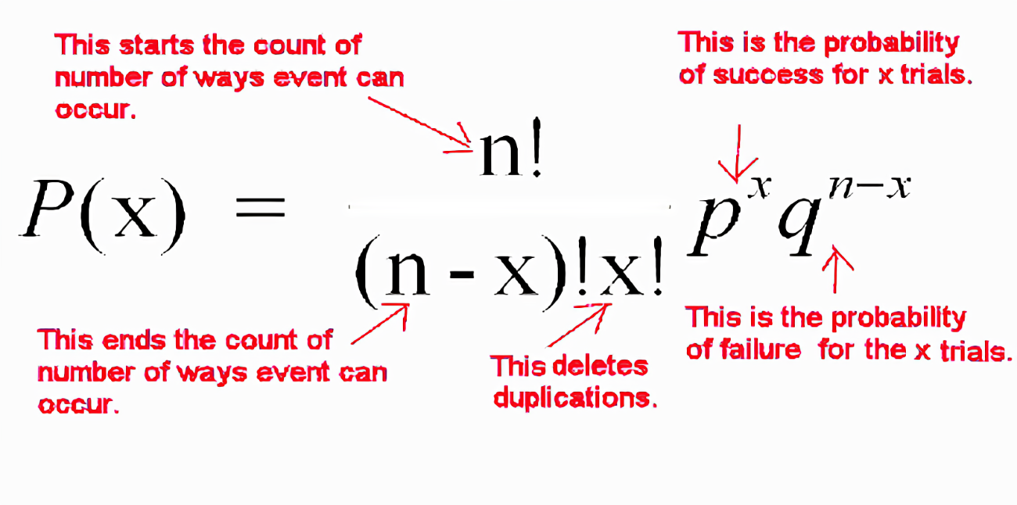
Definition
In probability theory and statistics, the binomial distribution is the discrete probability distribution that gives only two possible results in an experiment, either success or failure.
For example, if we toss a coin,
there could be only two possible
outcomes: heads or tails, and
if any test is taken, then there
could be only two results: pass or fail. This distribution is also called a binomial probability distribution.

Slide 3
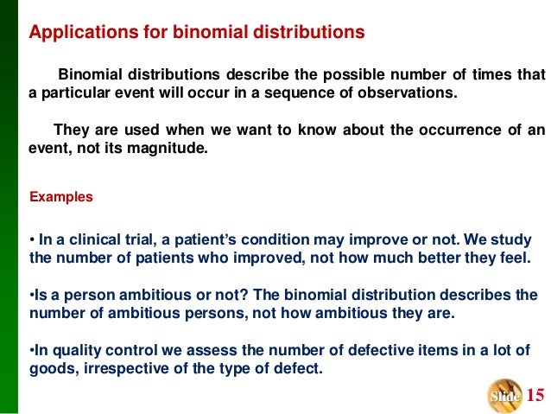
Applications of BINOMIAL DISTRIBUTION

Slide 4
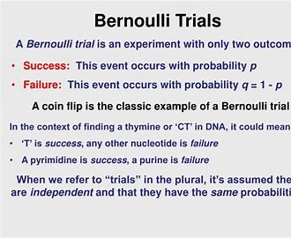
Binomial Distribution in Statistics
The binomial distribution forms the base for the famous binomial test of statistical importance. The binomial distribution represents the probability for 'x' successes of an experiment in 'n' trials, given a success probability 'p' for each trial at the experiment.
Two parameters n and p are used here in the binomial
distribution. The variable ‘n’ represents the number of
trials and the variable ‘p’ states the probability of any
one(each) outcome. A test that has a single outcome
such as success/failure is also called a bernoulli trial or
bernoulli experiment, and a series of outcomes is called
a bernoulli process.

Slide 5

IN real life
We already know that binomial distribution gives the probability of a different set of outcomes. In real life, the concept of the binomial distribution is used for:
Finding the quantity of raw and used materials while making a product.
Taking a survey of positive and negative reviews from the public for any specific product or place.
By using the yes/ no survey
To find the number of male and female students in a university.
The number of votes collected by a candidate in an election is counted based on 0 or 1 probability.

Slide 6

In business
We can model many complex business problems by using probability distributions. These distributions provide answers to questions such as: “what is the likelihood that oil prices will rise during the coming year?”,
“What is the probability of a stock market
crash next month?”, Or “how likely is it that
a corporation’s earnings will fall below
expectations this year?”

Slide 7

Example
A ski rental shop
In this case we can use a binomial distribution. In order to use a binomial distribution, we need to know how many events we’re measuring and the probability of individual success or failure .
In our rental shop case, we know that we can
expect 150 rentals on the busiest day, which
forms the number of independent events or trials.
We also know that, historically, 60% of our
customers rent skis and 40% rent snowboards, which provides our probability.

Slide 8
result
If we decide that we only need to have 65 snowboards in stock, what is the probability of running out of snowboard rentals on any specific day?
In this case, we want to know the probability that 66 or more customers out of 150 will want to rent a snowboard.
P(failure>65, trials=150, probability=0.40) = 13.9%.
This number is statistically significant, and indicates that we should increase our stock. For example, simply increasing our stock to 70 results in a much lower chance of failure:
P(failure>70, trials=150, probability=0.40) = 2.8%.

Slide 9

In medical science
A person infected with covid-19: probability of finding 0 or more number of people infected with covid-19 while examining 30 people; here, the random variable X is the number of “successes” that is the number of people found to be infected with the coronavirus.
Solution:-
The probability of finding a person infected with
coronavirus says, p.
The binomial distribution could be represented as
b(30,p).

Slide 10
More application in medical science
Application of binomial distribution to medicine:
Comparison of one sample proportion to an expected proportion (for small samples).
Evaluation of a new treatment.
Evaluation of a risk factor

Slide 11
THANK YOU FOR LISTENING TO MY PRESENTATION
ANY QUESTIONS

